Slide 1
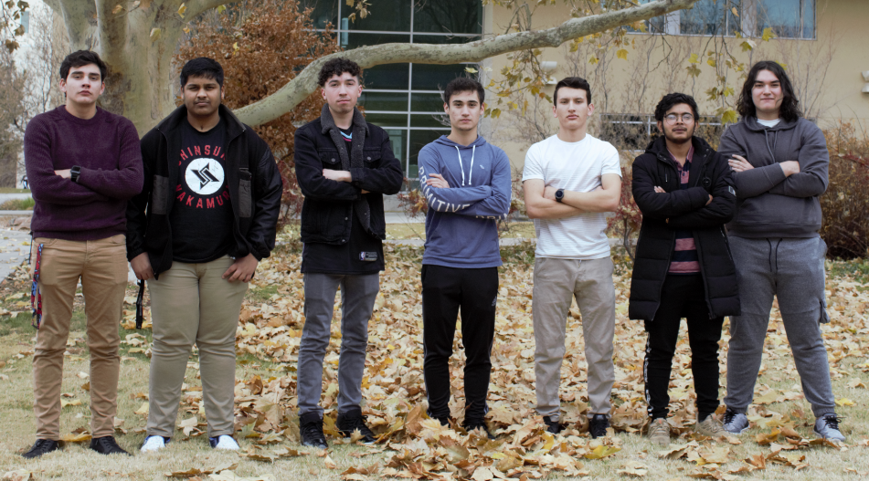
Custom engine short block assembly The ‘Odin 567’
The inner circle

Slide 2
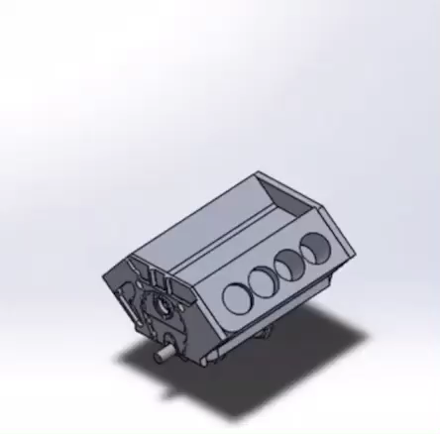
What we designed
Animation here
Custom engine short block based off the Chevy 454
567 Cubic Inches of displacement
Estimated 1000 Base Horsepower
Estimated 800 Foot Pounds Torque

Slide 3


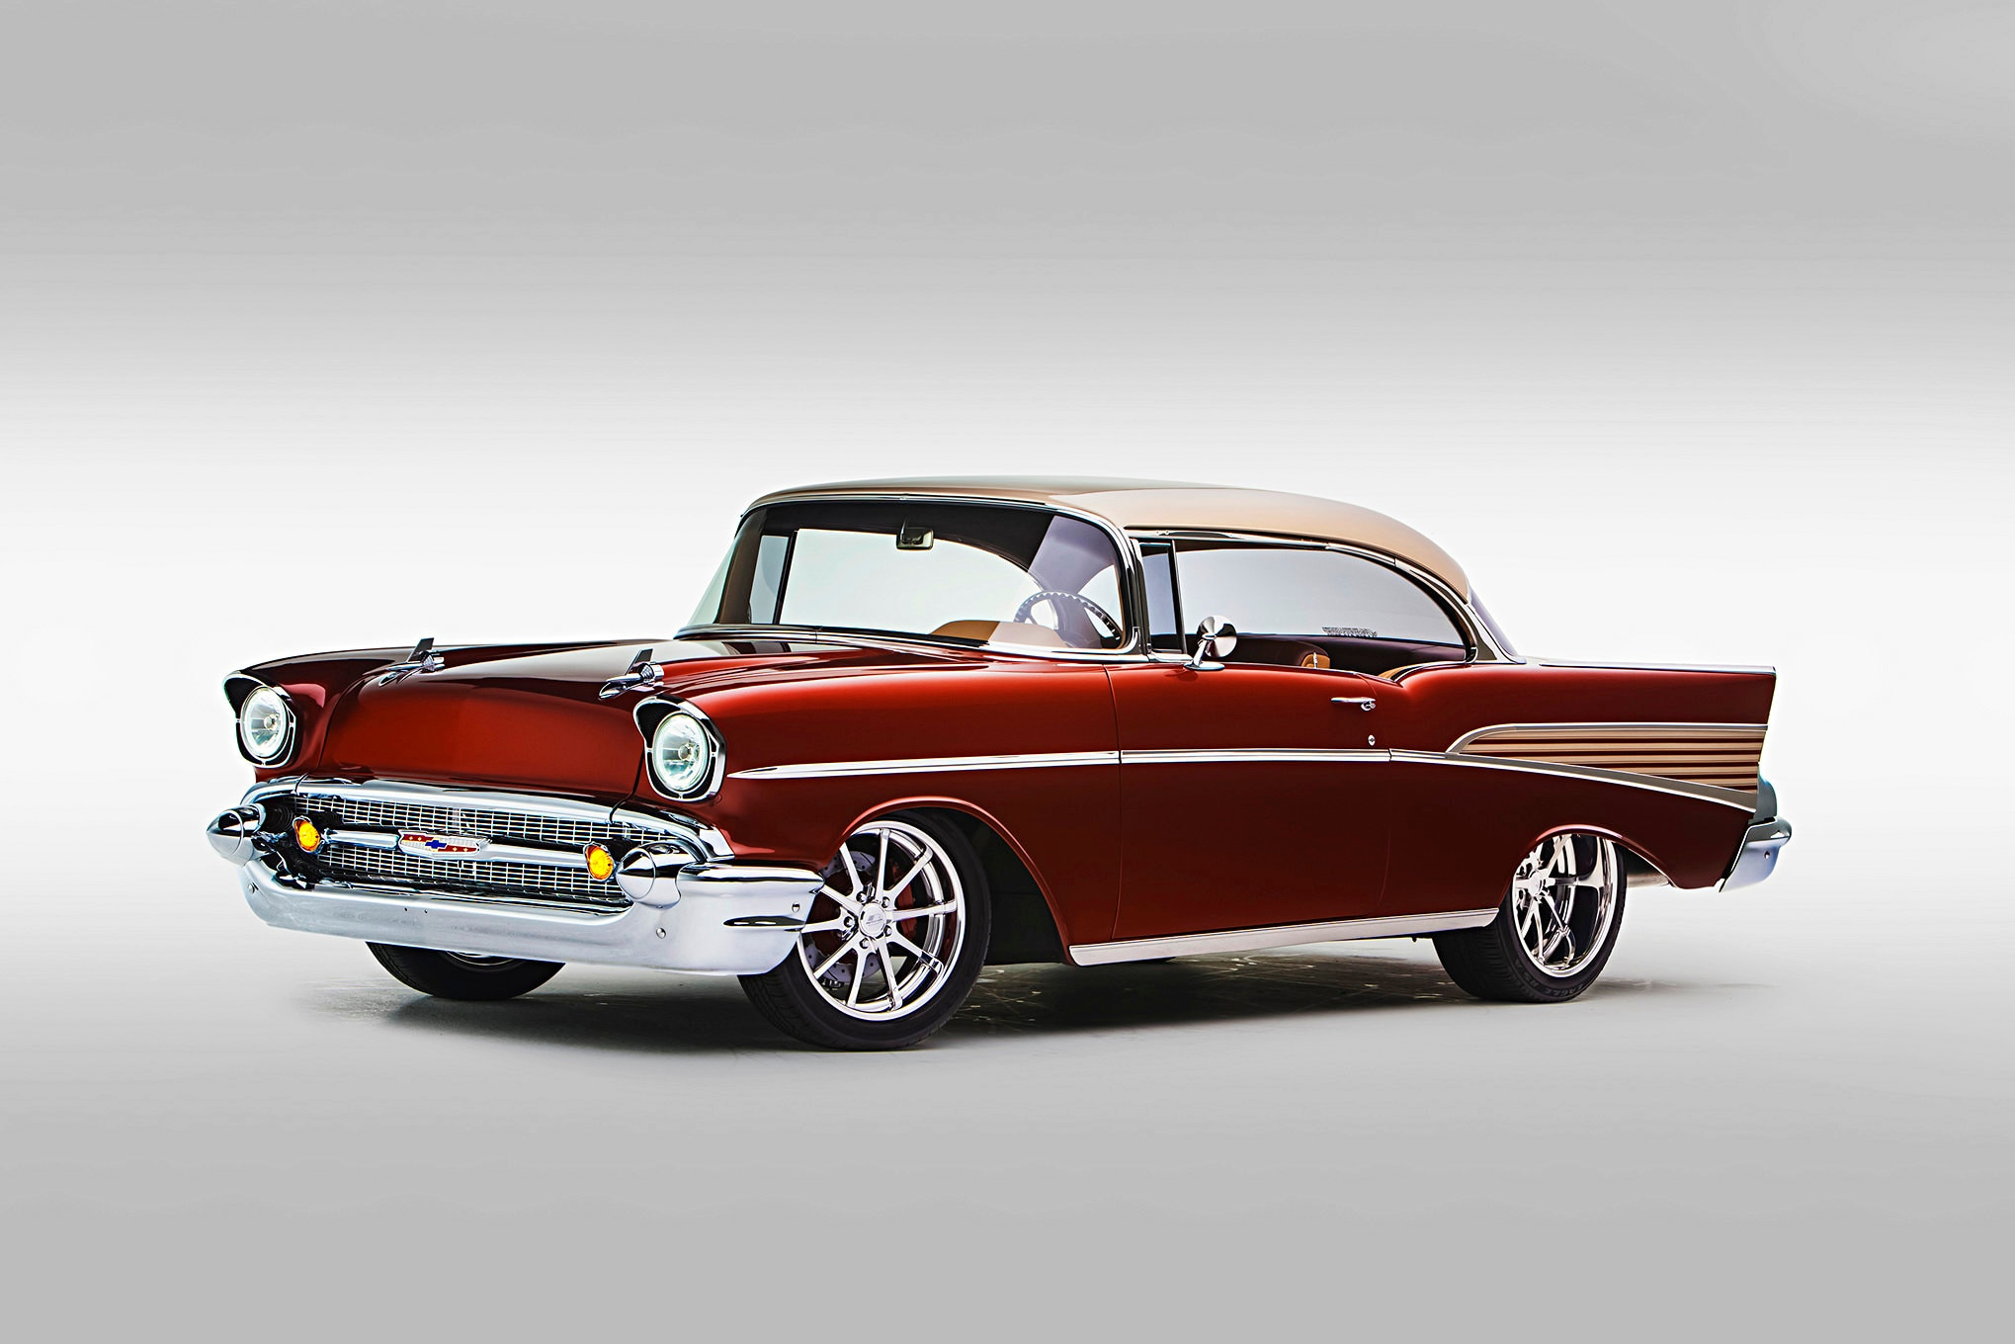
Some background information on big blocks and V8’s
First iterations came about after World War II
Cars grew bigger and so did the engines
Engines kept getting bigger for more power
Phased out in the 70’s for smaller, cleaner, less powerful engines

Slide 4
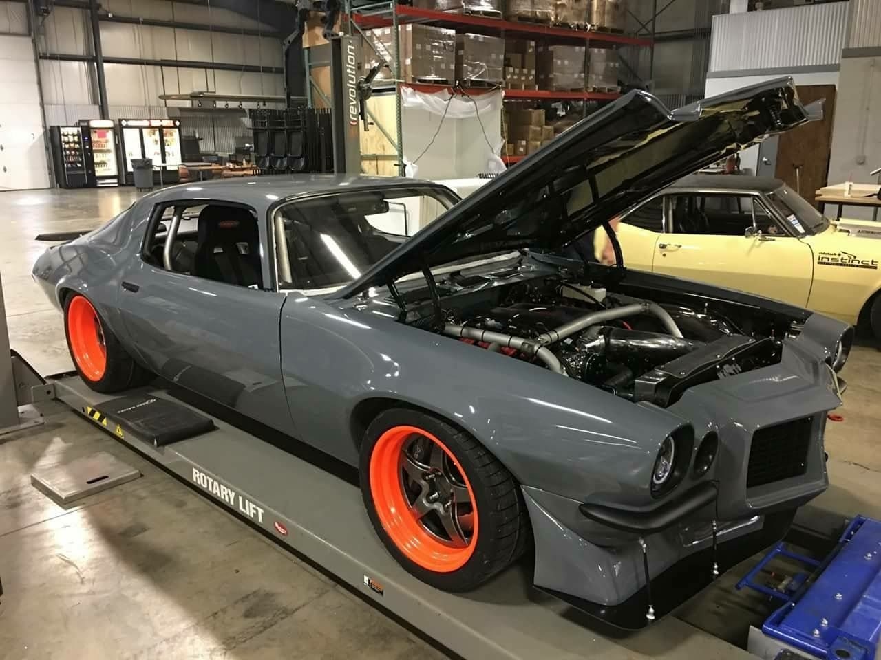
Practicality
Not for typical commercial use
Higher level of performance
Use in resto-mods
High power vehicles

Slide 5
Parts and drawings

Slide 6
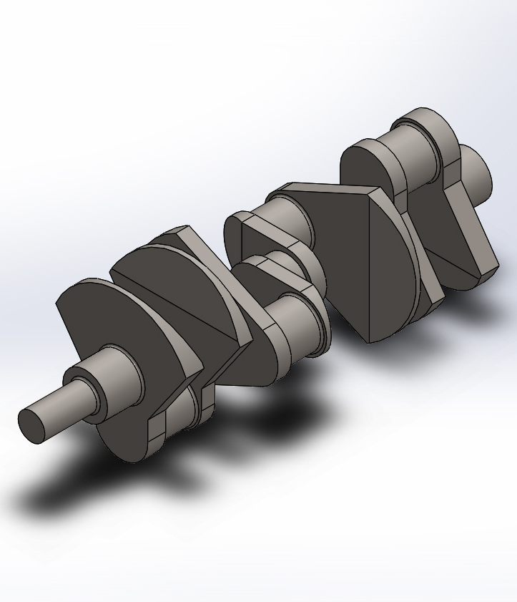
Crankshaft
What it does:
Turns linear motion of pistons into rotary motion
Responsible for engine firing order, stroke
Rotary motion of the crankshaft is then transferred to the transmission which puts the power to the wheels
What We Changed:
New improved counterweight design to improve balance and reduce weight
Longer stroke for more displacement
Forged from 4340 Steel for higher durability and strength

Slide 7
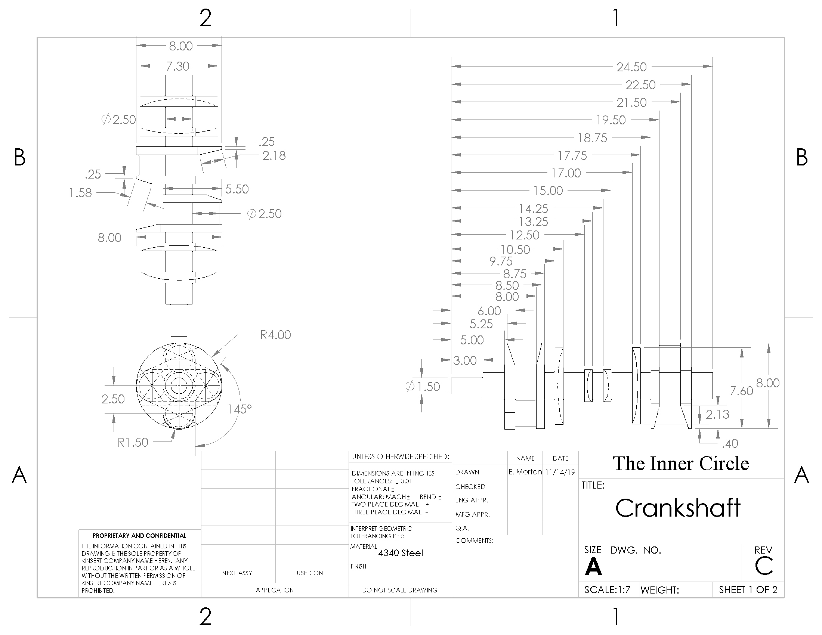
Crankshaft Continued

Slide 8
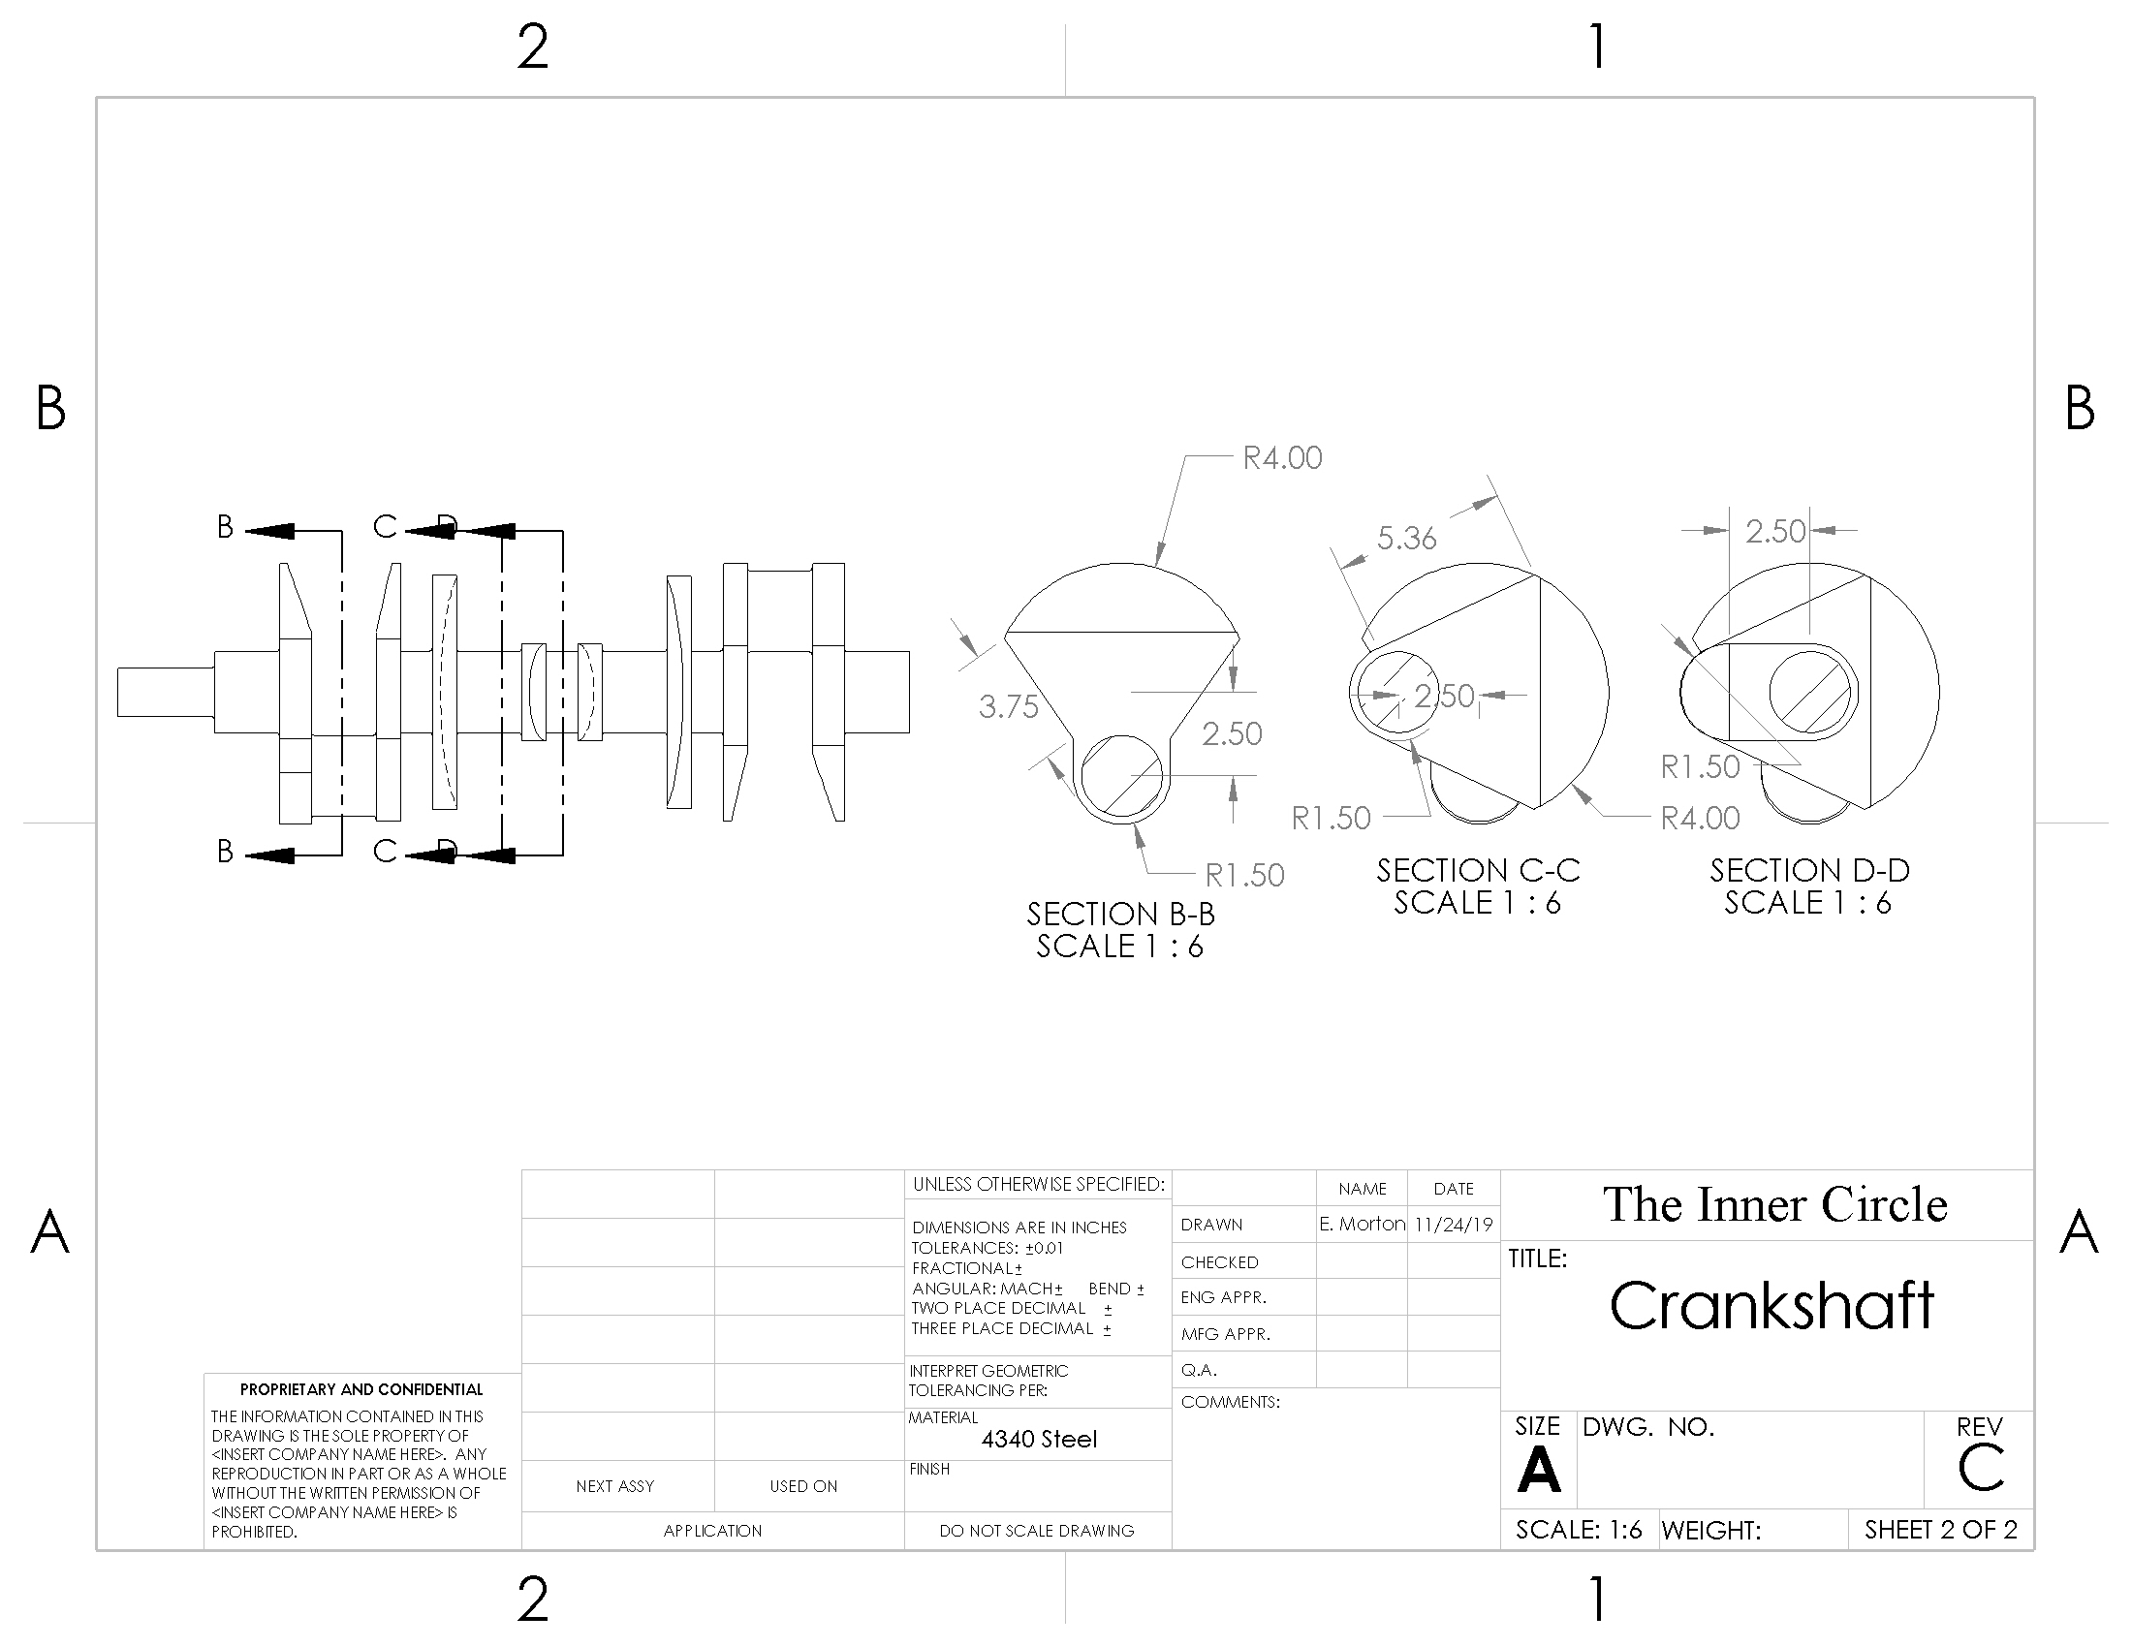
Crankshaft Continued

Slide 9
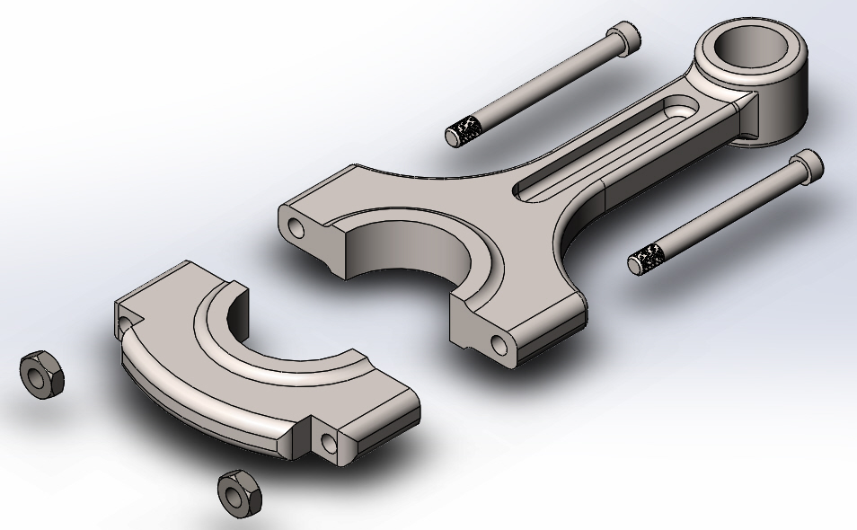
Connecting Rod Assembly
What it does:
Connects the piston to the crankshaft
Rotates freely at both ends to account for the rotational movement of crankshaft
What we changed:
Forged from titanium
Custom shape (width and length)
Aerospace grade bolts

Slide 10
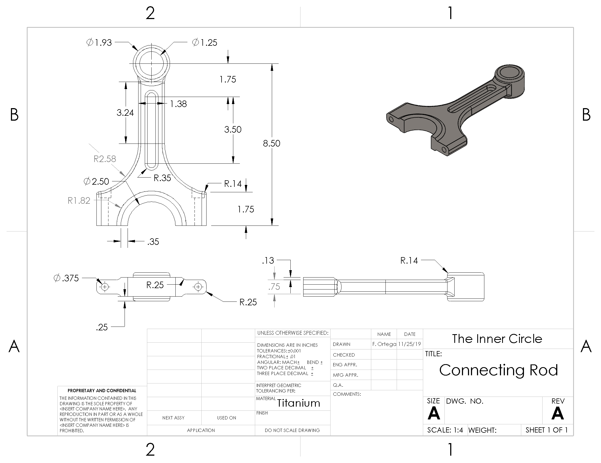
Connecting Rod

Slide 11
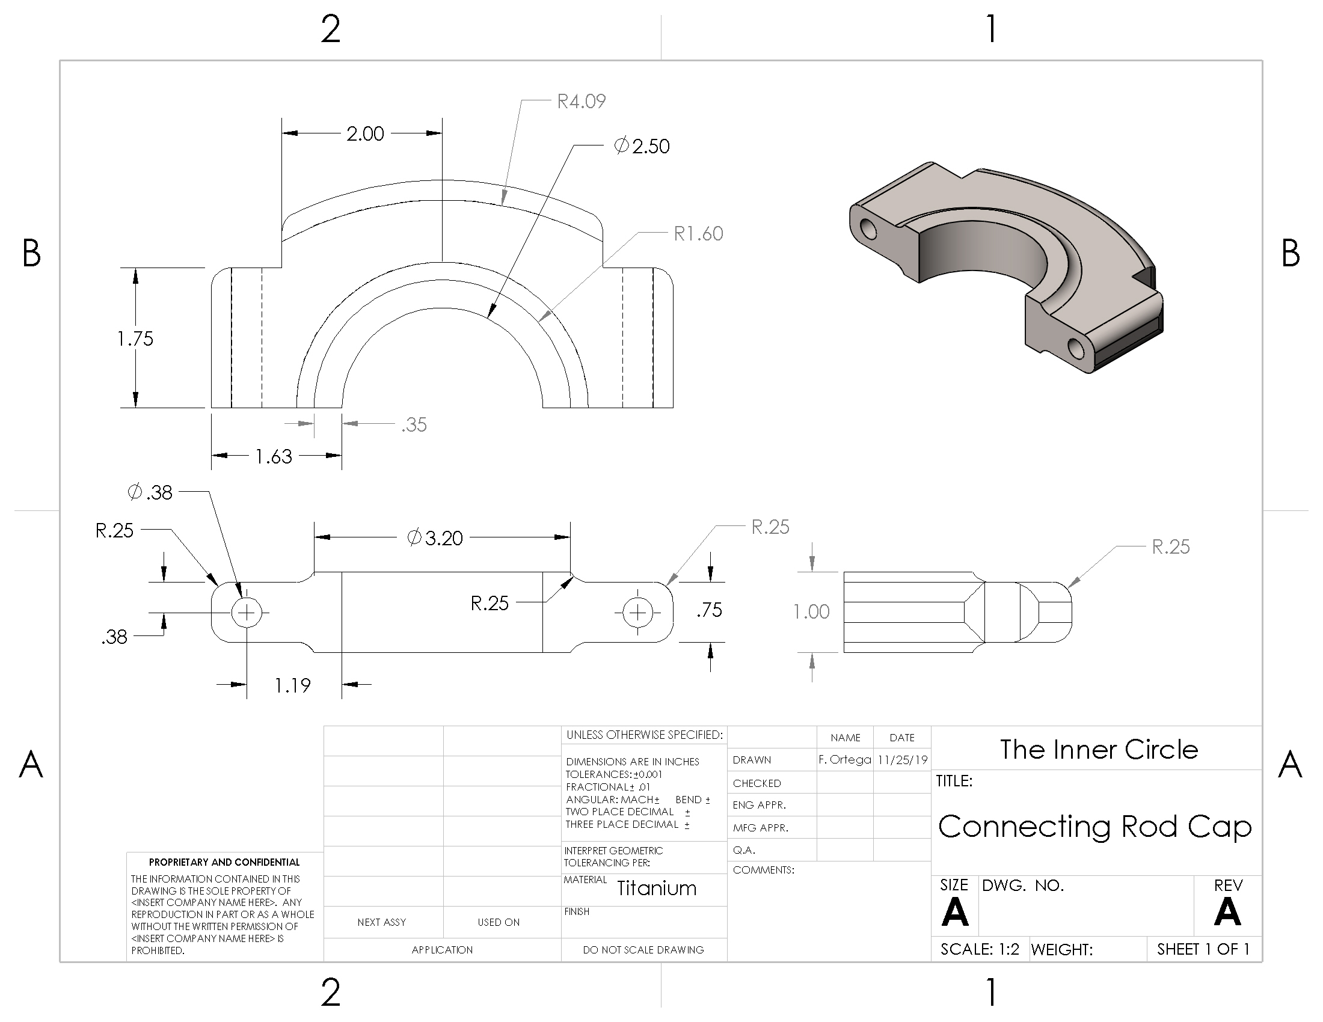
Connecting Rod cap

Slide 12
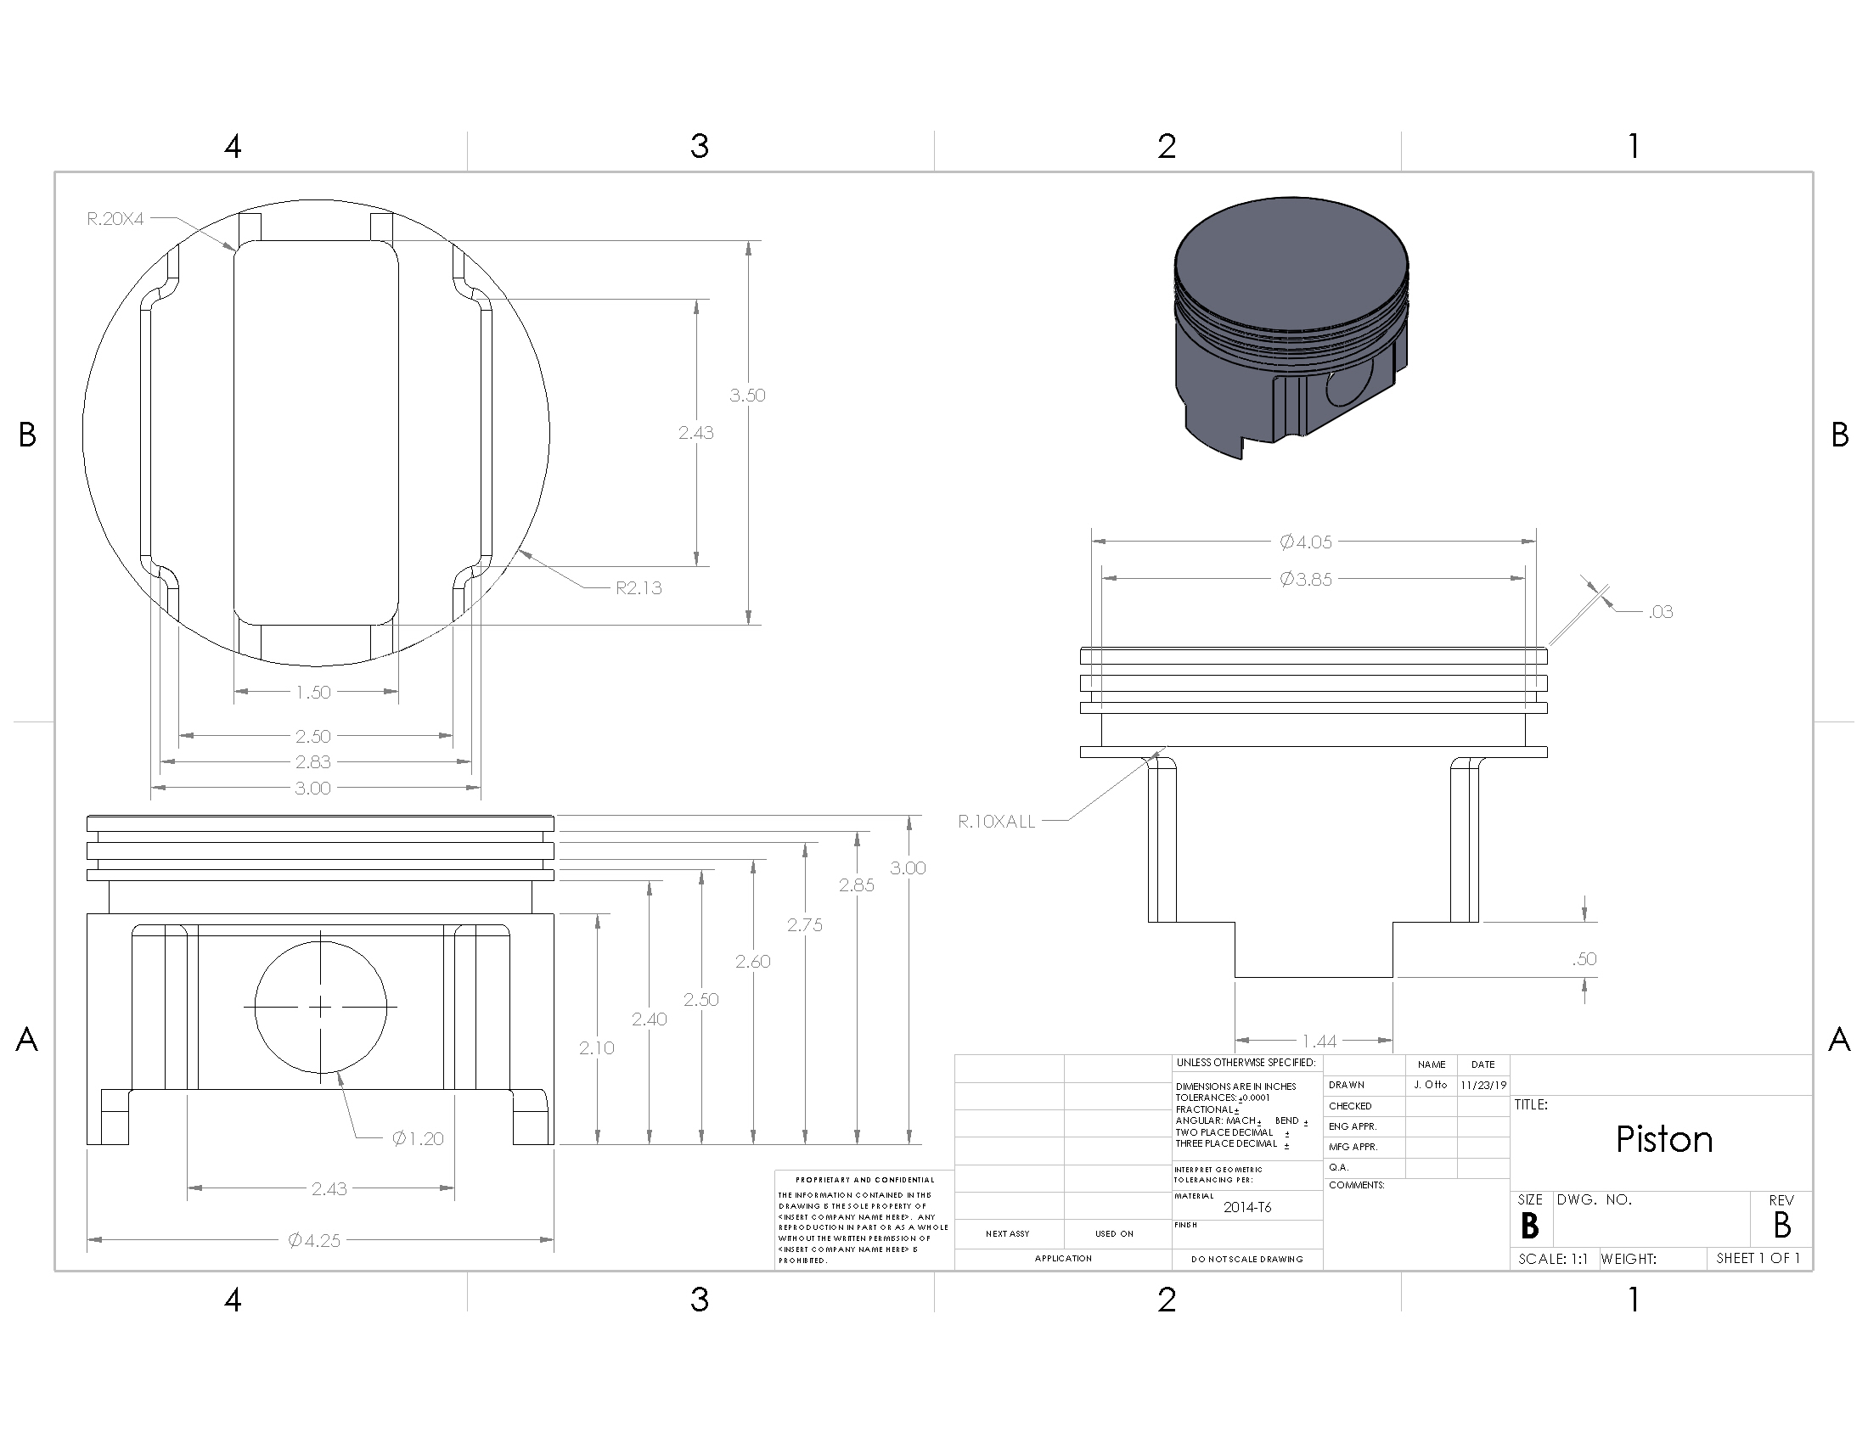
Piston
What it does:
Handles the combustion process in the cylinder
What we changed:
Stock bore size 4.25in, but can be bored out to 4.5in
Forged 2014-T6 aluminum
Flat top for maximum flame propogation

Slide 13
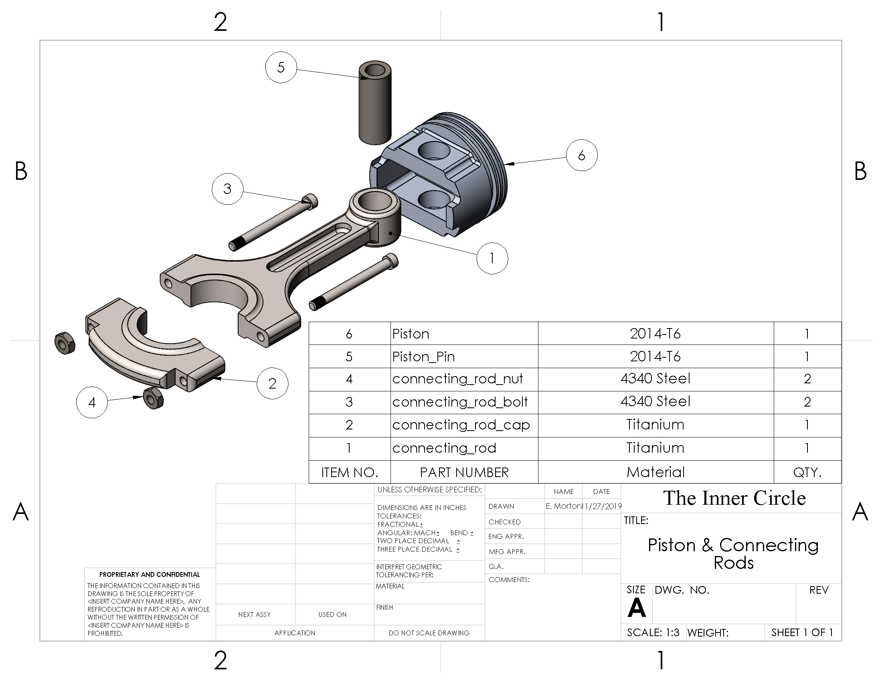
Pistons and piston pin

Slide 14
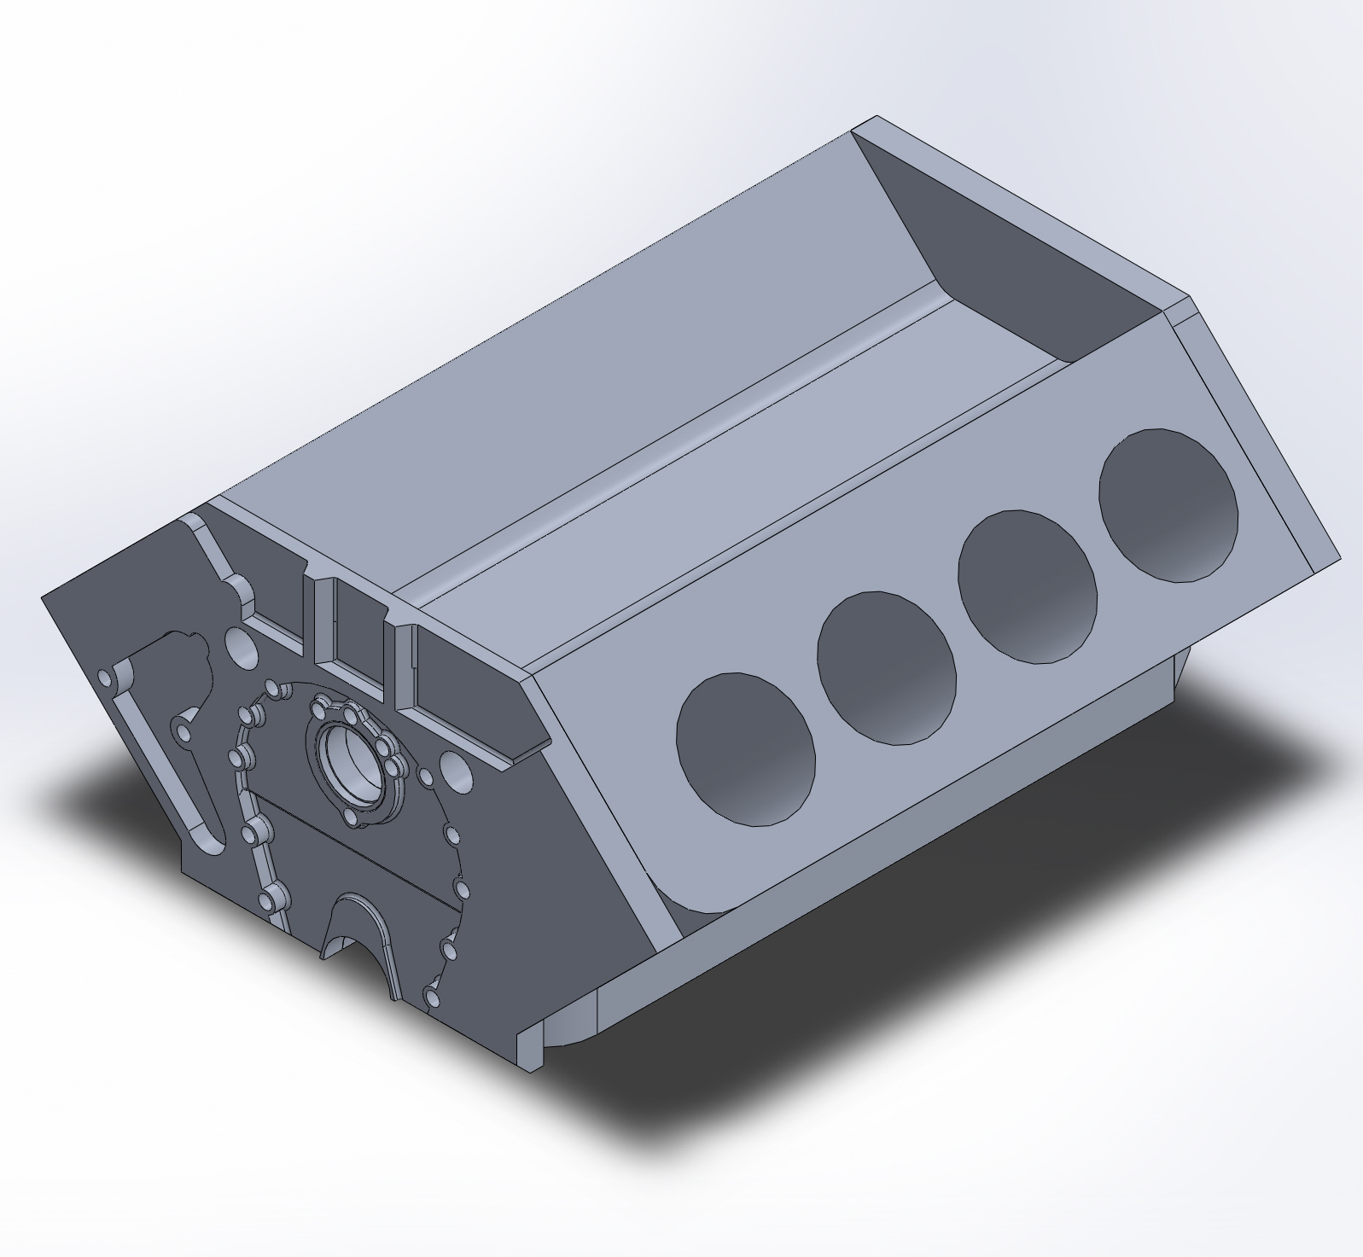
Block
What it does:
It holds all the components of the engine.
It transfers heat from the friction of reciprocating assembly to the atmosphere and engine coolant.
What we changed:
The present block provides more displacement.
The material we have gone with is 2014-T6, because of its high strength/ hardness and lightweight nature compared to stock cast iron.

Slide 15
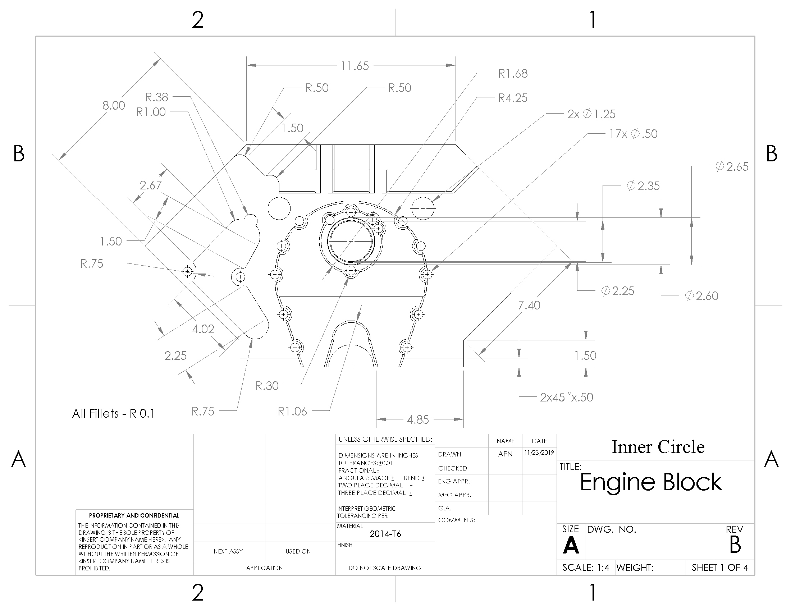
Engine block Continued

Slide 16
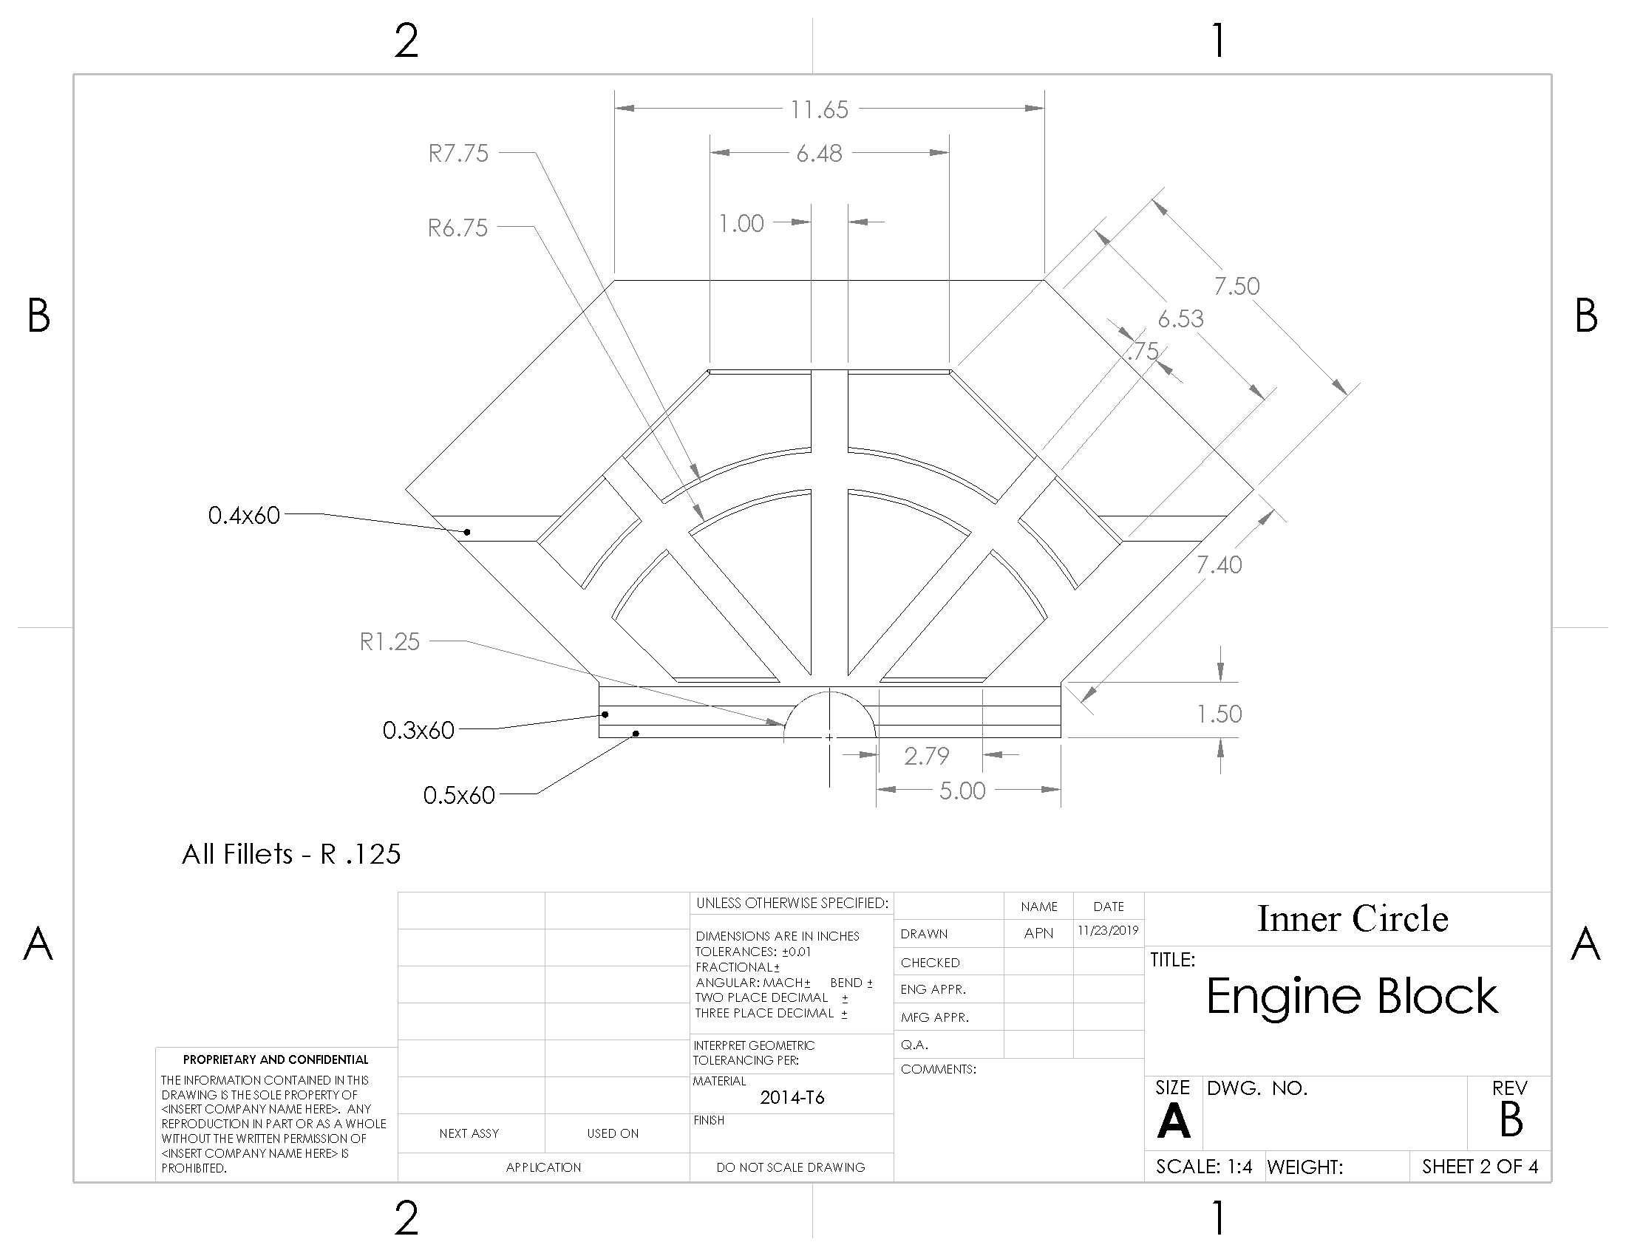
Engine block Continued

Slide 17
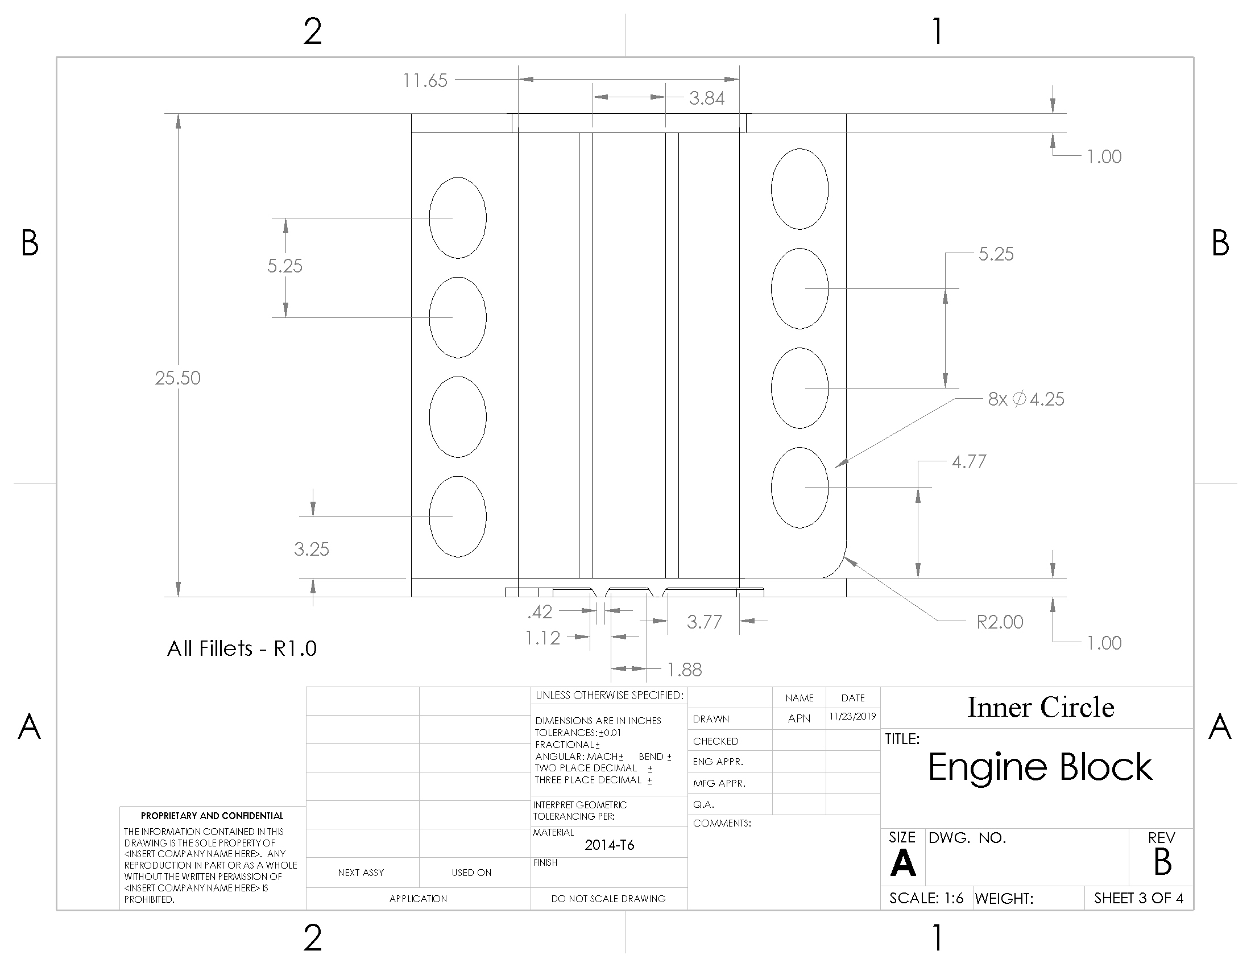
Engine block Continued

Slide 18
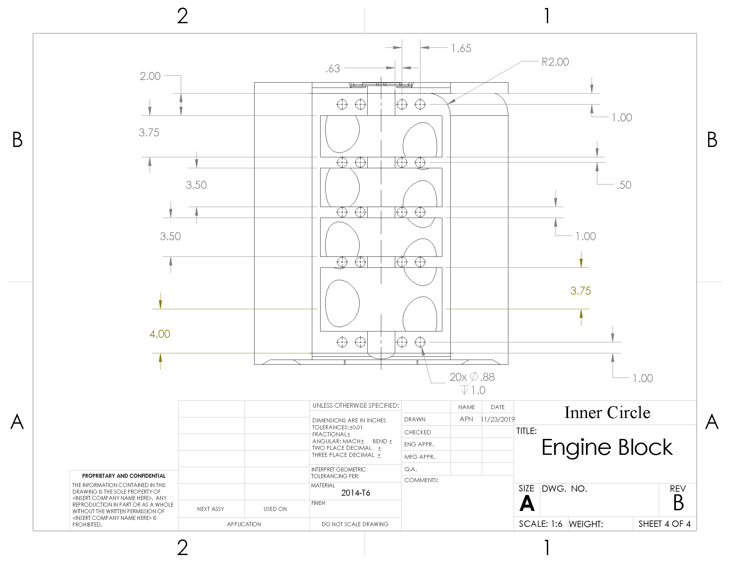
Engine block Continued

Slide 19
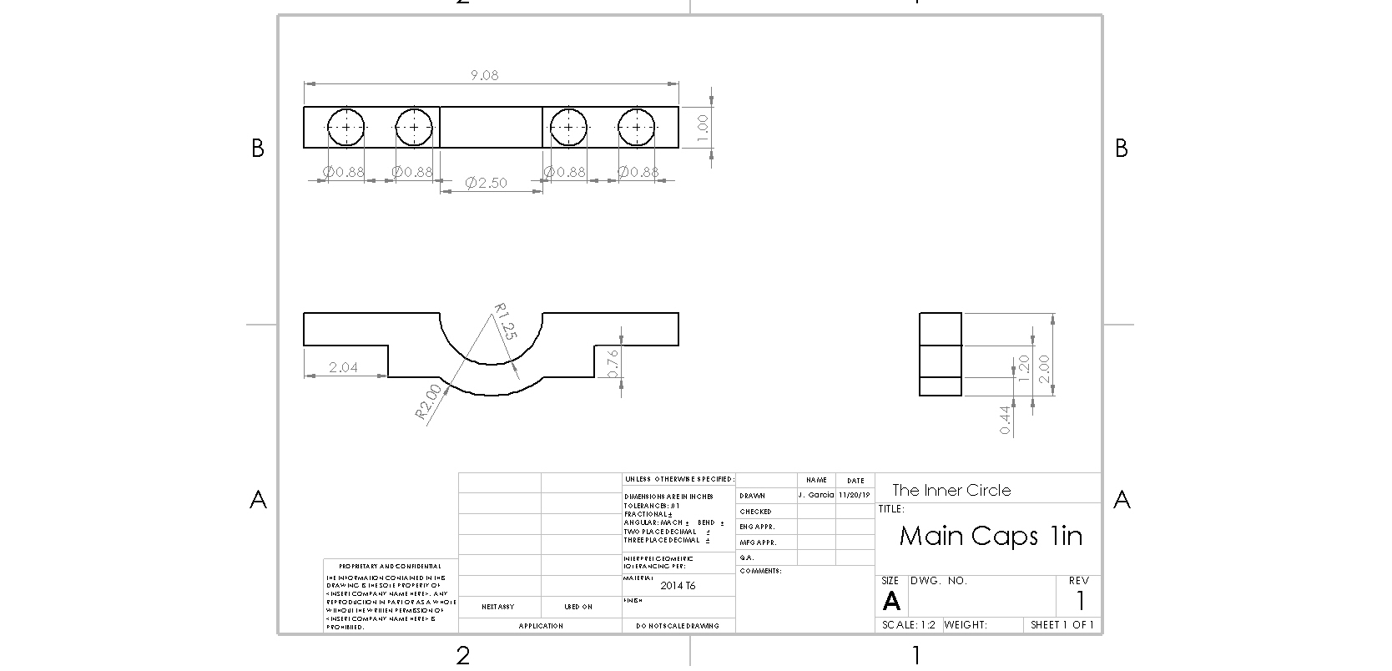
1-inch main caps

Slide 20
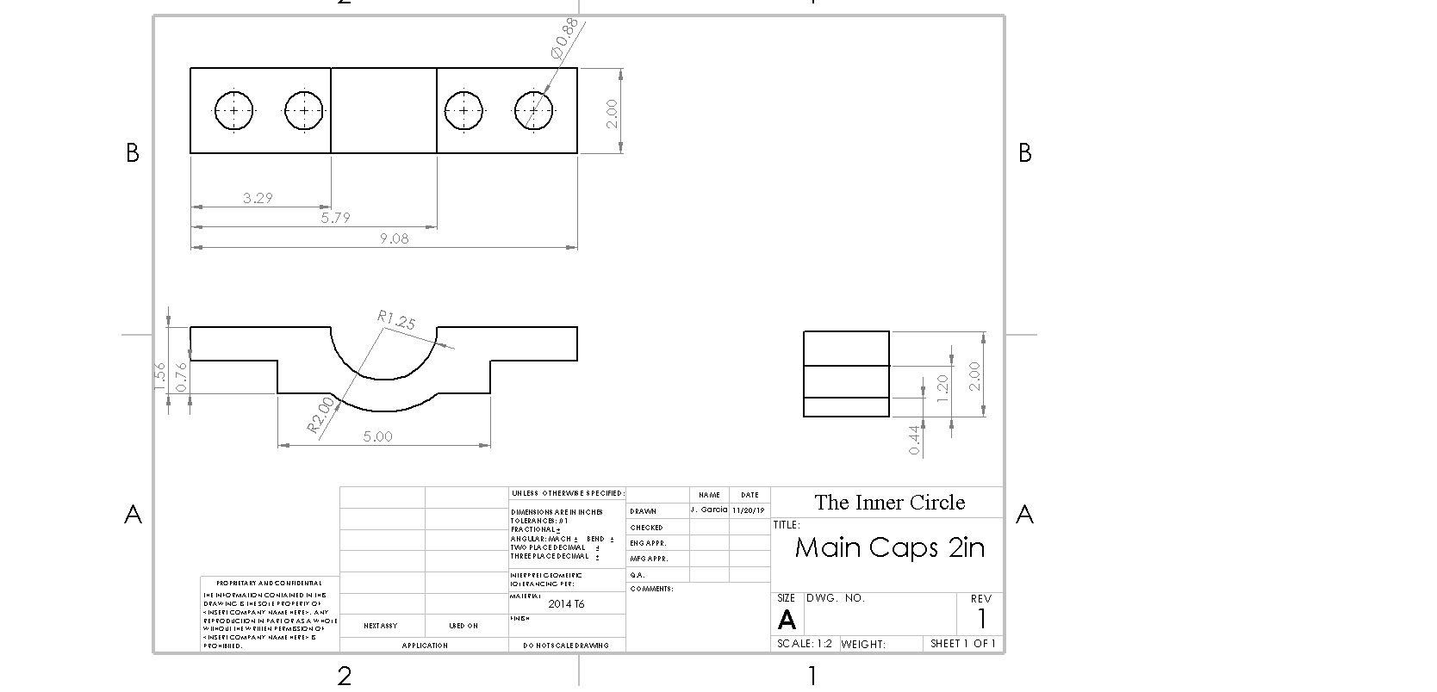
2-inch main caps

Slide 21
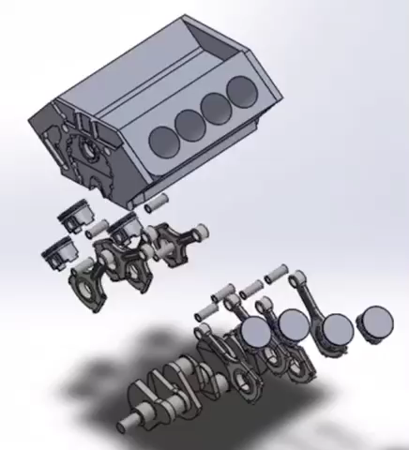
Finished Assembly

Slide 22
Machining Processes

Slide 23
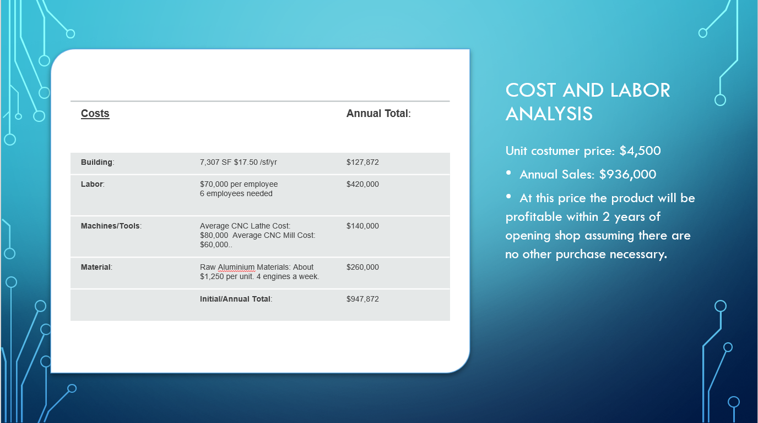

Slide 24
Why we did this project

Slide 25
Works Cited
“ATK High Performance Chevy Gen V 489/496 Short Blocks SP98.” Summit Racing Equipment, www.summitracing.com/parts/hpe-sp98/.
“Chevrolet Big-Block Engine.” Wikipedia, Wikimedia Foundation, 6 Nov. 2019, en.wikipedia.org/wiki/Chevrolet_big-block_engine.
“Find about Titanium Connecting Rods and Why Are They so Loved by Motorists.” Find about Titanium Connecting Rods and Why Are They so Loved by Motorists, www.titaniumexposed.com/titanium-connecting-rods.html.
Motortrend.com. “2017 Dodge Viper Reviews - Research Viper Prices & Specs.” MotorTrend, Motor Trend, 21 Oct. 2019, www.motortrend.com/cars/dodge/viper/2017/.
“SB Chevy 350 Race Prepped Engine Block - 2 Piece Seal, 4 Bolt Main.” CNC Motorsports, www.cnc-motorsports.com/sb-chevy-350-race-prepped-engine-block-2-piece-seal-4-bolt-main.html.
“The Chevrolet Big Block V8 Engine.” The Novak Guide to The Chevrolet Big Block V8 Engine, www.novak-adapt.com/knowledge/engines/about/chevy/chevy-big-block-v8/.
“Ultimate Guide to Building Chevy-Big Blocks: Cylinder Blocks Instruction: 454 Big Block, Chevy, Building.” Pinterest, www.pinterest.com/pin/689684130414908068/.
“What Are the Most Common Metal Fabrication Processes and What Are the Applications?” Tuckey, 31 Oct. 2019, www.tuckey.com/blog/common-metal-fabrication-processes-applications/.
Wires, Noria news. “How Car Engines Are Manufactured.” Reliable Plant, Noria Corporation, 15 Jan. 2016, www.reliableplant.com/view/30371/car-engines-manufactured.
“2018 Used CNC Machine Price: Average CNC Machine Price.” ManufacturingTomorrow, www.manufacturingtomorrow.com/article/2018/12/2018-used-cnc-machine-price-average-cnc-machine-price/12676/.
LoopNet.com. “2105 Osuna Rd NE, Albuquerque, NM, 87113 - Office Space For Lease.” LoopNet, www.loopnet.com/Listing/2105-Osuna-Rd-NE-Albuquerque-NM/17223786/.
Salary.com. “Machine Shop Production Supervisor I Salary.” Salary.com, www.salary.com/research/salary/benchmark/machine-shop-production-supervisor-i-salary.

